Slide 1

Green Pace
Security Policy Presentation
Developer: William Colon
Notes:
Hello, this is William Colon from CS 405 presenting the security policy for green Pace.

Slide 2

OVERVIEW: DEFENSE IN DEPTH
This security policy is intended to provide a secure and robust protection policy within the real of defense in depth. It utilizes core security principles, C and C++ coding standards, encription policies, Triple A and appropriate unit testing to provide a multi layered defense against any threats.
Notes:
in an overview defense in depth involves adding layers of defense tactics to construct a web that traps prey or arcade security threats. This security policy implements this notion using security concepts, CN C++ standards, encryption, AAA policies, and unit testing examples. It will also address certain issues and security policy advice for fixing them.

Slide 3
THREATS MATRIX
Threads are ranked by similarity and priority. How often to seek for and automate a thread depends on its likelihood. Priority threads may cause the most product and security disruptions, so handle them immediately.
Likely STD-001-CPP STD-002-CPP | Priority STD-003-CPP STD-004-CPP STD-005-CPP
Low priority STD-008-CPP STD-009-CPP STD-010-CPP | Unlikely STD-006-CPP STD-007-CPP
Threads are ranked by similarity and priority. How often to seek for and automate a thread depends on its likelihood. Priority threads may cause the most product and security disruptions, so handle them immediately.
Notes:
Our graphic on this slide shows a threats matrix that ranks standards by likelihood and priority if ignored. If there's a common threat, we can automate or implement a policy to mitigate it. If there's a greater threat, we need to focus on that before a minor threat.

Slide 4
10 PRINCIPLES
Validate Input data
Data type
Data value
Head compiler warnings
Data type
String correctness
Memory protection
Architect and design for security policies
SQL Injection
Exceptions
Expressions
Containers
Object Oriented programming
Keep it Simple
Containers
Object Oriented programming
Default deny
Exceptions
Expressions
Object Oriented programming
Edhere to the principle of least privilege
Exceptions
Expressions
Containers
Sanitize data sent to other systems
Memory protection
Practice defense in depth
Object Oriented programming
Memory protection
Data type
Data value
SQL Injection
Use effective quality assurance techniques
Assertions
Exceptions
Expressions
Adopt a secure coding standar
Containers
Object Oriented programming
Notes:
10 security policy concepts and criteria for validating input types and ensuring data and value. If compiler warnings appear, developers should consult them. Data management, types, string validity, and code implementation are covered.
Architecting for security policies reduces development and other security threats like SQL injections by generating secure programs. Keep it simple—these guidelines emphasize security. If it fits all product criteria, it's easier and more efficient to maintain and build lower standards to enforce this approach. Denying by default prevents security risks. Risk by believing everything is a security risk until proven otherwise locks down until authorized. The standards support this idea. Providing only the minimum privilege needed to execute a task, similar to default, keeps unauthorized users away from sensitive data. Sanitizing data from other systems make things safer by removing dangers. These standards enforce this principle. These standards use defense and depth, like the spider web I discussed previously, because transmissions affect memory or data type weaknesses. Quality insurance tests and reviews the goods to assure quality. These criteria illustrate it. A secure coding standard ensures product consistency. Comparable items are easier to build, test, and fix. The standards support this mindset.

Slide 5
CODING STANDARDS
Find the weaknesses that will damage the product most to least when ranking them. The coding standards state that data type, SQLinjection, and memory protection will do the most damage, thus they should be mitigated first.
Finding the vulnerabilities that would harm the product the most or the least should be taken into consideration when rating them. According to the described coding standards, memory protection, SQL injection, and data type are likely to cause the most damage and should be addressed first.
After determining the extent of the damage, it's critical to ascertain the probability that the issue will arise. The most frequent mistakes in C/C++ coding are likely data type/value and string accuracy, thus they should be found first.
Both existing and future mistakes can be found and prevented by properly testing and orienting the code. Standards like assertions, exceptions, expressions, containers, and oop encourage effective code and testing.
Data Type
Data Value
String Correctness
SQL Injection
Memory Protection
Assertions
Exceptions
Expressions
Containers
Object Oriented Programing
Notes:
we have our 10 coding standards, which help us mitigate vulnerabilities, but if one happens, we rank them based on what will do the most to the least damage to the product or service. Once the level of damage is identified, we can determine the likelihood that something will happen.

Slide 6
ENCRYPTION POLICIES
Encryption at rest:
Full-disk encryption at the server level and server-wide encryption rules at the database level will be used to encrypt data while it is at rest. Both will make use of additional backup plans in the event of a significant breakdown and recovery.
Encryption in flight:
All incoming and outgoing data exchanges in the cloud, including messages, attachments, file transfers, web traffic, and other forms of communication, will use public key infrastructure to encrypt data. To stop malicious behavior, password access, SSH, and limited communication channels will be used.
Encription in use:
The data in use will make use of least privileged role authority to restrict access to the necessary actions and functions and identity security protocol to ensure that the correct person is granted access only when all fields of identification are satisfied. It will be easier to guarantee that access levels are reviewed in order to protect sensitive data if a system with multi-tiered clearance for access modification requests is used.
Notes:
Now we have the three main encryption policies first is encryption at rest or the hardware level and the code level on our end so full dis encryption for server and databases help provide security at the development level encryption in Flight is during the transmission of data how do we keep it safe encryption of incoming and outgoing data of all types via SSH password access and other safety methods help prevent malicious intent finally encryption and use proper identification to ensure that only authorized users are utilizing in the product help keeps things safe a least privilege approach keeps people away from sensitive data above their clearance and change request approval systems allow for tracking of changes

Slide 7
TRIPLE-A POLICIES
Authentication
the method of recognizing a user, typically through the use of a username and password. This regulates the user's access to the system in order to guarantee that only individuals with permission can access it.
Authorization
Authorization gives authenticated users access to a least privilege system so they can manage their amount of mobility and authority. This also permits the deletion of all access, adjustment of access, and addition of new users.
Accounting
The tracking of users' interactions with the system is called accounting. It tracks both the files that user's access, and any modifications made to the database by them.
Notes:
Either an or the policies below boost personnel security by authenticating users by login or security key and indicating their access level. authorization allows authenticated users to be granted access to whatever level of privilege a least privilege system requires. We can vary the level of access from new to existing to eliminating people. Accounting involves monitoring all activity to identify potential threats.

Slide 8
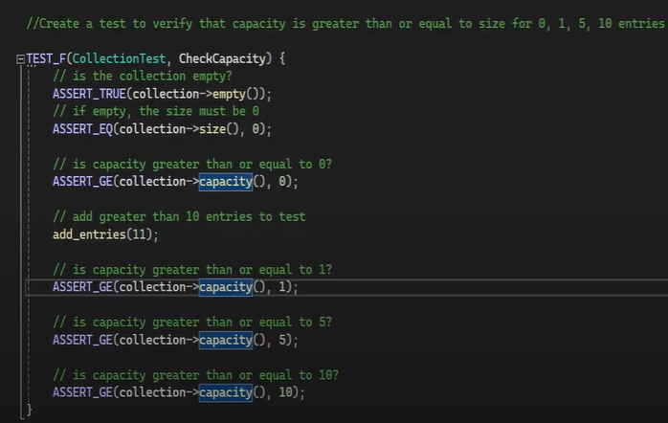

Unit Testing Check Capacity
Notes:
We have a test to see how much a collection can hold to start our unit testing examples of putting the rules and policies we talked about earlier into action. Do the checks for amounts bigger than or equal to standard amounts pass if we add items? It does go through.

Slide 9
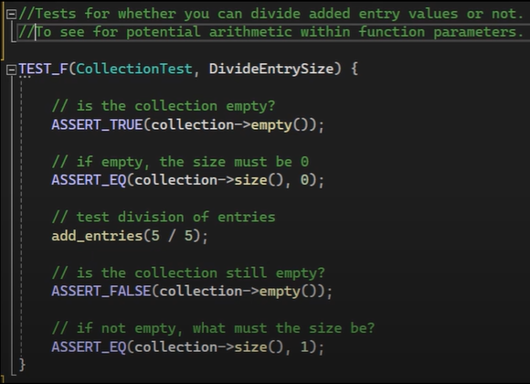

Unit Testing Divide Entry Size
Notes:
In later, more complex code, we check that the container is empty and then divide five by five to add one to the entry. We make sure that only one entry is added.

Slide 10
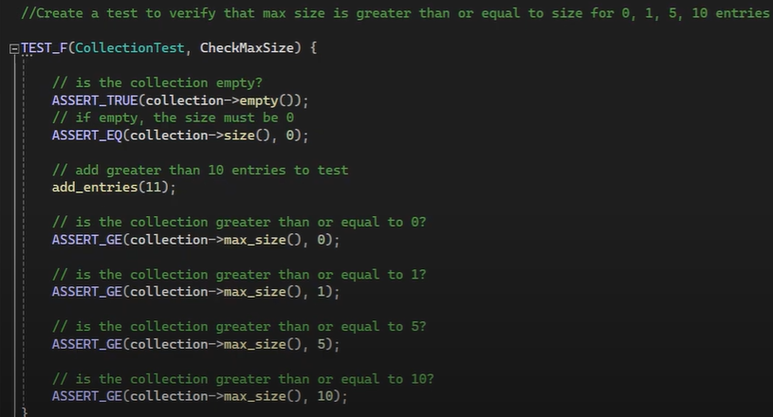

Unit Testing Max Size
Notes:
It's called "max_size" for a reason. To make sure the collection isn't empty, we first add 11 values and then make sure we have more than or equal to the usual testing values, which are 0, 1, 5, and 10.

Slide 11
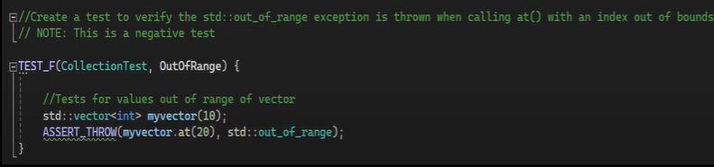

Unit Testing Out of Range
Notes:
Our first negative test checks for values within a vector and adds 10 values. If we access outside the 10 values, we look for the 20th value, which doesn't exist. If our test works, it should throw an error or pass with the assert throw statement.

Slide 12
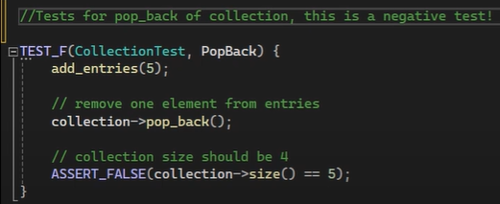

Unit Testing Pop Back
Notes:
As with the first negative test, we want to make sure that something fails when it should fail. In this case, we want to see if the pop back method removes the value at the end of the collection. To test this, we add five. Take one out and then make sure the collection size isn't the same as it was before.

Slide 13
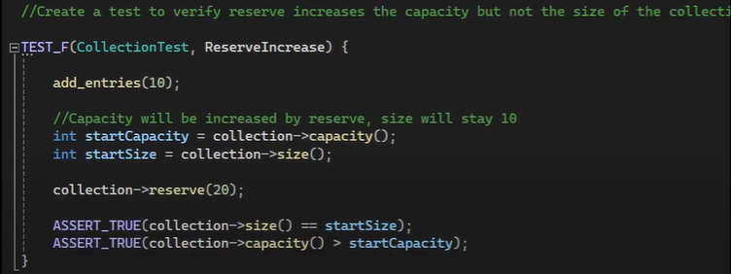

Unit Testing Reserve Increased
Notes:
our last test is checking to see if when increasing the reserve of the collection or the capacity increases but the overall size stays the same.

Slide 14

AUTOMATION SUMMARY
Notes:
In short, our automation overview says that the dev SEC op system moves between pre-production and production. To keep track of progress at each step, you have to go back and forth. This picture shows all the stages and what happens in each one.

Slide 15
TOOLS
The DevSecOps pipeline is a constantly evolving and developing system that integrates security through out the entirety of the development and live portion of the product.
Security tools are layered through out the automation process. Within the design area, test design is created. In the build area, building the code securely is implemented. Within the verify and test area tools like unit testing are used. Transition and health check is where security measures may be adjusted and monitor and detect is the use of security tools in live environments. Maintain and stabilize identifies the level of effectiveness of the security and returns status to normal.
Examples of tools include:
Parasoft C/C++ test – Used in the testing portion of the design.
Load Ninja – Used in the verify and pre production section.
Intruder – Postproduction tool that monitors the health of the system and performs penetration testing.
Notes:
During the automation process, Dev SEC Ops uses security tools to make sure that testing is done at all stages of development to keep an eye on the health of the product. Paris often loads Ninja is focused on development, while Intruders is focused on post-production and does testing that looks like attacks from bad people.

Slide 16
RISKS AND BENEFITS
Pros:
Provides security focus throughout entire development and post development cycle
Early and continuous implementation allows for easier and more effective approach.
Provides greater defense against attacks and poor code quality.
Allows for less damage if an attack where to occur as each section can be a reference point in security development.
Cons:
Upfront cost
Time Commitment
Higher level of development required
Increases complexity and size of product and scheduling.
Concusion:
Overall, using automation and early security development has far more benefits than drawbacks. Considering that a future security breach could cost 10 times as much as the initial investment, the time and money spent now are a small investment. Integrating security across the whole product development process guarantees that the defense is robust and capable of fending off a wide range of possible threats.
Notes:
There are pros and cons to security policy. The pros include constant security during the entire development cycle and post-development cycle, which lets us test the product earlier and more often to make sure it meets standards. This makes the product safer before it goes into production and is released, instead of testing for all possible errors after the fact. The cons include the time and money commitment, and it does take a lot of work to schedule and build the system. However, the small cost of investment is much less expensive than paying for damages if there is a security breach.

Slide 17
RECOMMENDATIONS
Build Pre_production: There are no declared repositories. Implementation of trusted repositories will be required.
For each step, there is no established method of enforcement. must decide on and put into place an appropriate enforcement strategy to guarantee that all requirements are fulfilled.
The encryption theory is examined, although no encryption level is mandated. Standard encryption must be implemented, with the option to change it as needed to meet client or product requirements.
Notes:
this policy does have a few flaws, pre-production has no depositories refined no enforcement for each stage and the encryption ideology is discussed but never enforce or examples provided

Slide 18
CONCLUSIONS
“Version control capabilities” let you keep track of changes, improve collaboration, and have built-in tools for code review. This will help keep output consistent, see what changes were made, and plan for future development processes.
Since there is no way to ensure each step, it could lead to code that is duplicated and doesn't change. Enforcements can "...automatically delete data that has exceeded its retention period" or stop users who try to access data without permission.
The idea behind encryption is to change how data can be seen by using a program or method that hides the data so that it stays safe and secure unless the right key or password is given to see it. lists Triple DES, AES, RSA, Blowfish, and Twofish as examples of encryptions.
Notes:
Referring to the suggestions on the previous slide, we say that a well-defined repository has many benefits, such as the ability to track changes, offer built-in review tools, and support version control. not following through on each stage Could lead to misunderstanding, stuck code, and extra work Some ways to make this better are to have data automatically deleted when its retention time is up and to block users who try to access data without permission. It is important to secure data to keep it safe, so we could use triple Dees, RSA Blowfish, or two fish.
This is the end of my presentation. Thanks for watching.

Slide 19
REFERENCES
Create and run load test in half the time. LoadNinja. (n.d.) http://loadninja.com
An Effortless vulnerability scanner intruder. (n.d.) http://intruder.io
Bluestain, N (2024, may 24). What is a code repository$ Harness. Harness.io http://harness.io/harness-devops-academy
Log Management and analysis software made easy. Logentries. (n.d.) http://logentries.com

